Slide 1
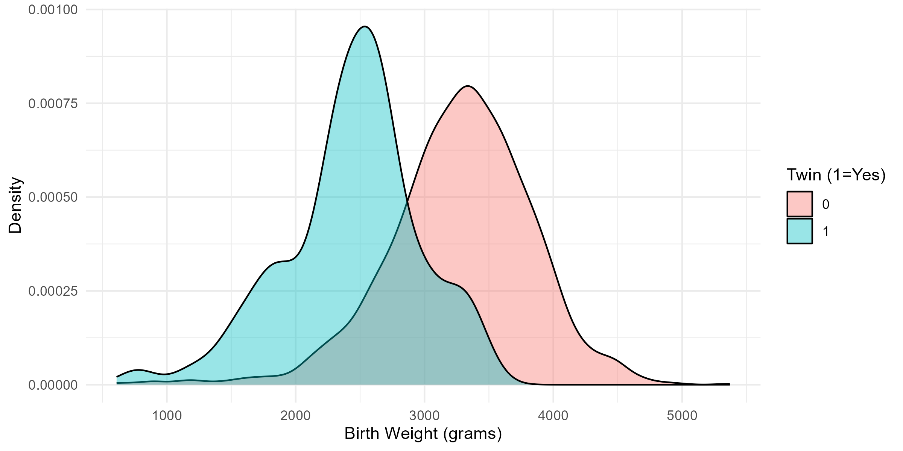
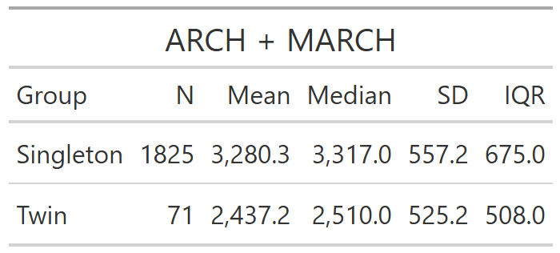
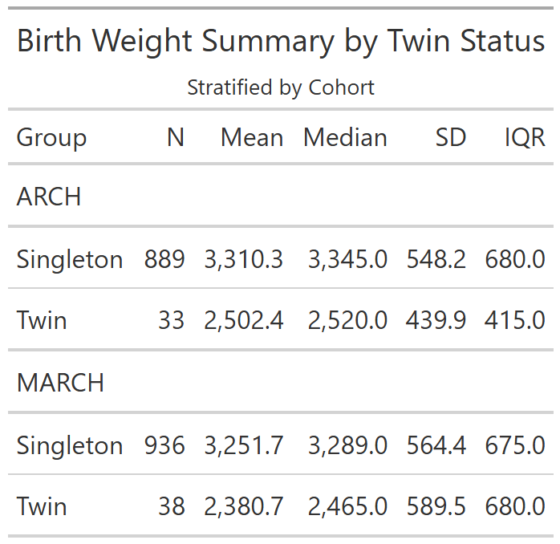
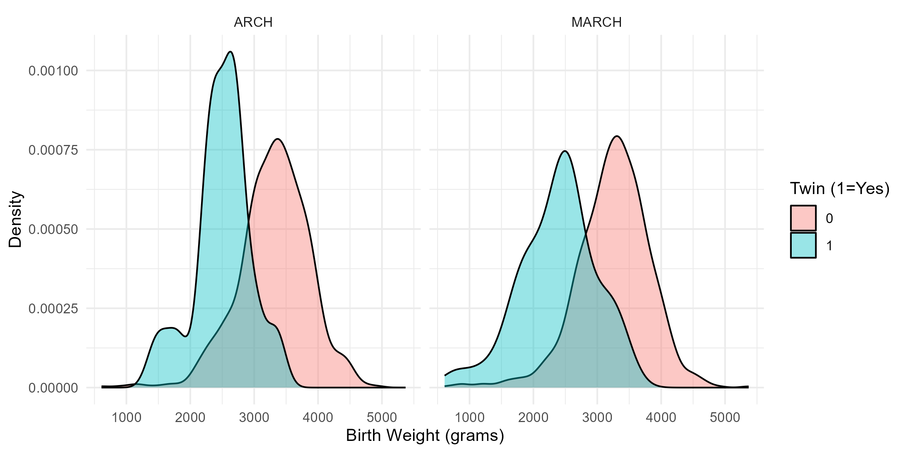
Twin Birth Weight (Grams)
Overall, twins exhibited significantly lower birth weight compared to singletons. Further analyses should account for gestational age.
Notes:
Check if triplets exist Check the number of twin sets

Slide 2
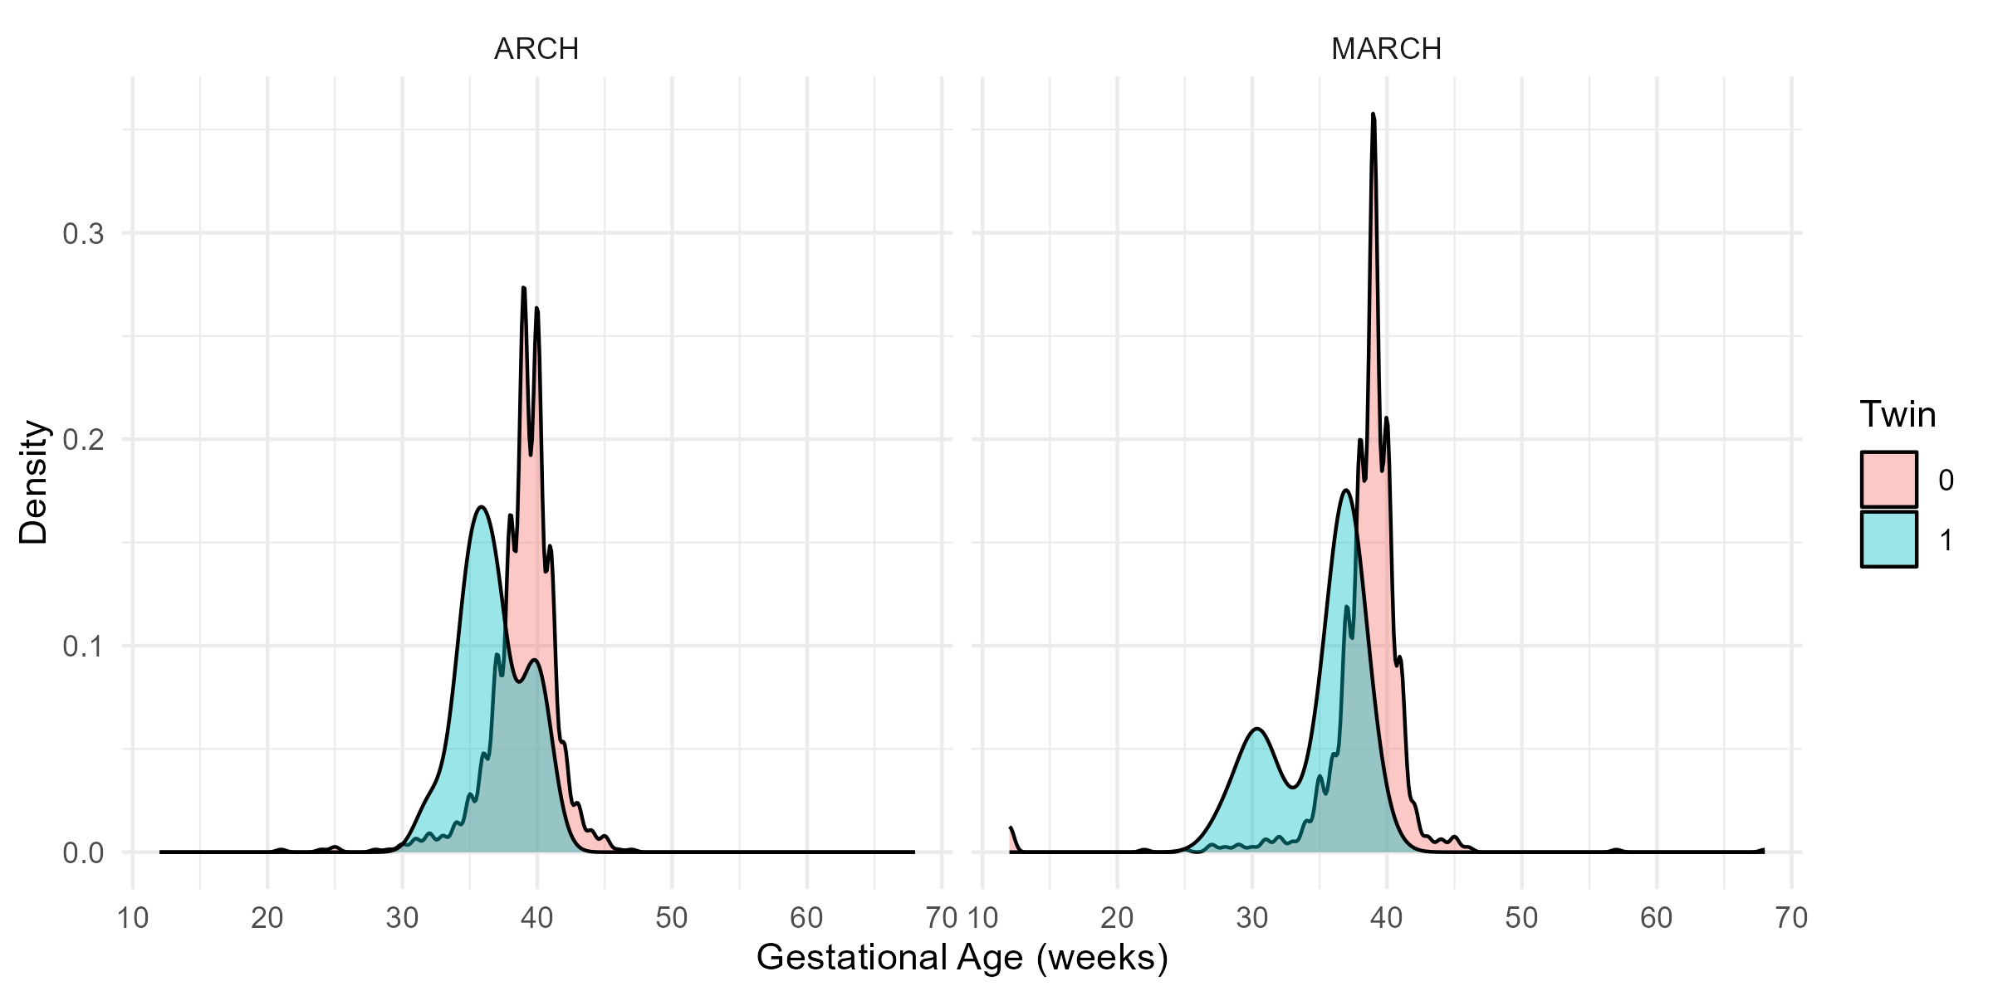
P < 0.05
P < 0.05

Slide 3
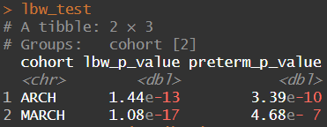
< 2500 grams
Twins had significantly higher rates of low birth weight and preterm birth compared to singletons in both cohorts, suggesting increased risk of adverse birth outcomes among twins.
< 37 weeks

Slide 4
